Slide 1
Evaluating the Accuracy of ML-based Near Offset Data Reconstruction with Increasing Gap Size
Arvin Boutik Karpiah, Asiah Hanida Burhanuddin, Law May, N Farees Putra N Hassan, Syadhisy Dhanapal
Open

Slide 2
Problem Statement
Near offset reconstruction is important in producing high-quality seismic data. It impacts many subsequent processes in the seismic processing workflow such as:
Surface-related multiple estimation (SRME)
Reverse Time Migration (RTM)
Amplitude Variation with Offset (AVO)
Challenges with conventional interpolation methods:
Operational issues during acquisition (large gap size)
Computational cost (large survey area)
Huge interest the geoscience community in applying ML-based solutions for seismic trace interpolation with good results in both synthetic and field dataset
How accurate is ML-based near offset reconstruction with respect to increasing gap size?
Hypothesis: ML-based interpolation would struggle to fill in traces as gap size increases

Slide 3
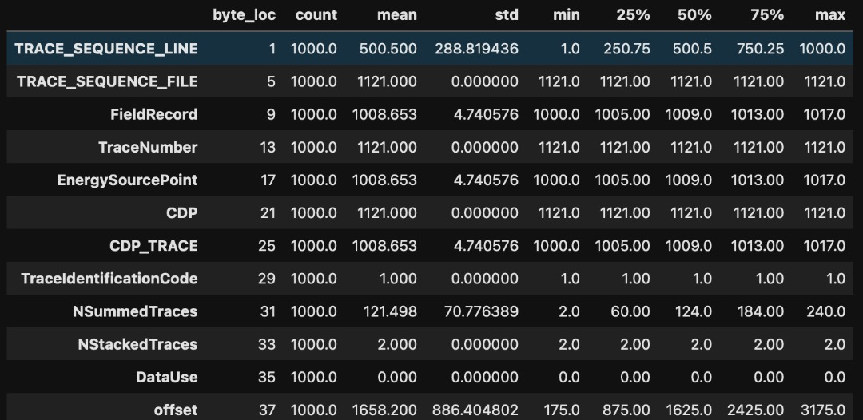
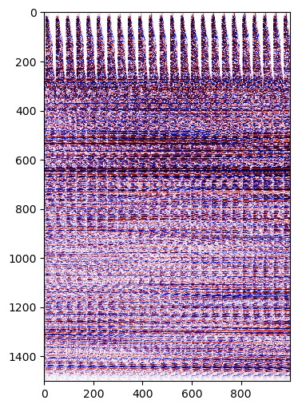
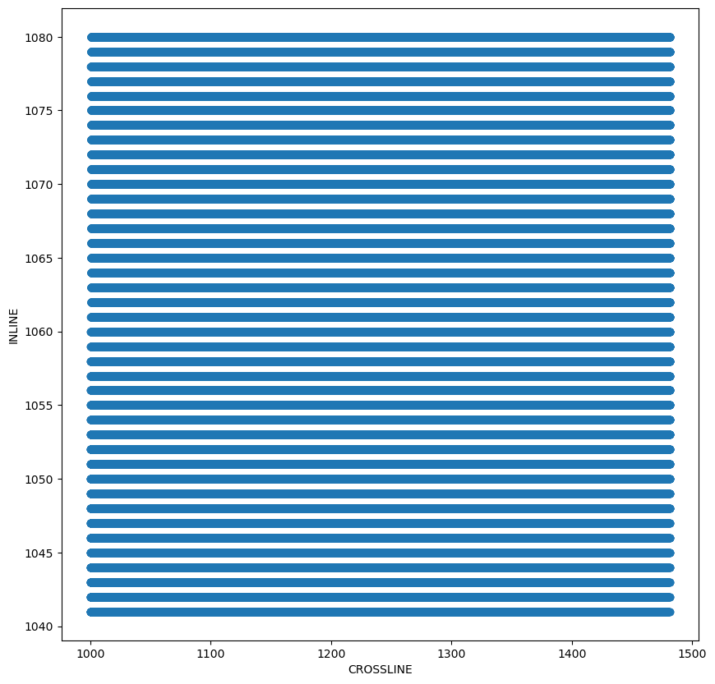
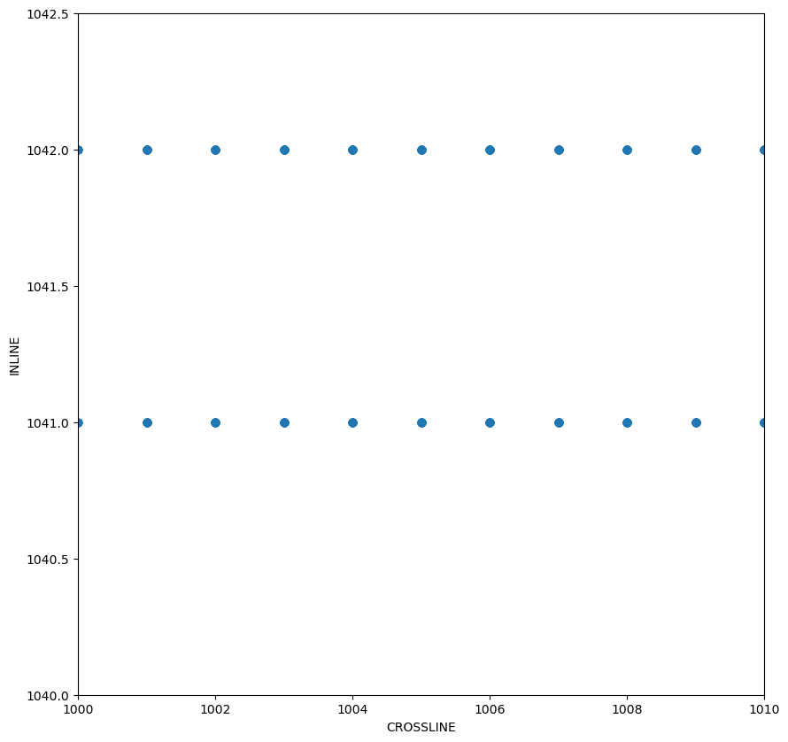
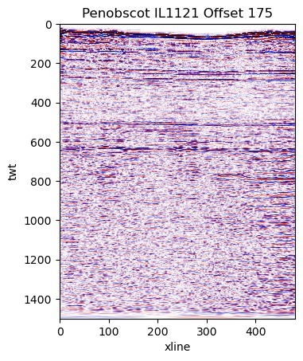
Data Investigation
3D Penobscot, Offshore Nova Scotia, Canada, working with 3D CMP Gathers
Trace Headers of 3D CMP Gathers (DataFrame)
3D CMP Gathers (CMP Domain) IL1401
TWT
CDP
Bird’s Eye View of CDP Location
Offset 1 from IL1401
Zoomed Section
TWT
CDP

Slide 4
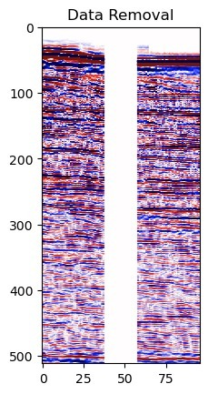
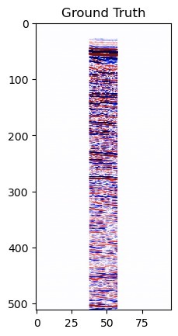
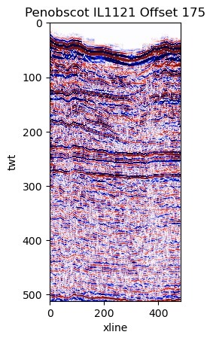
Data Preparation
Input Data (40, 5, 512, 96)
Output Data (40, 5, 512, 96)
5 patches per iline
Input Data
Output Data
40 ilines

Slide 5
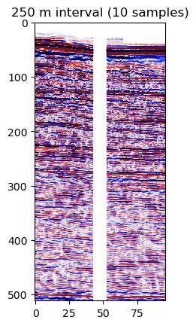
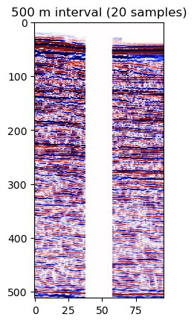
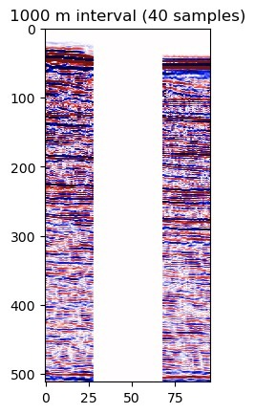
Data Masking
Replace with zero
x
x
Non-Zero
Non-Zero
Train-test Split: 66.6% - 33.3%

Slide 6
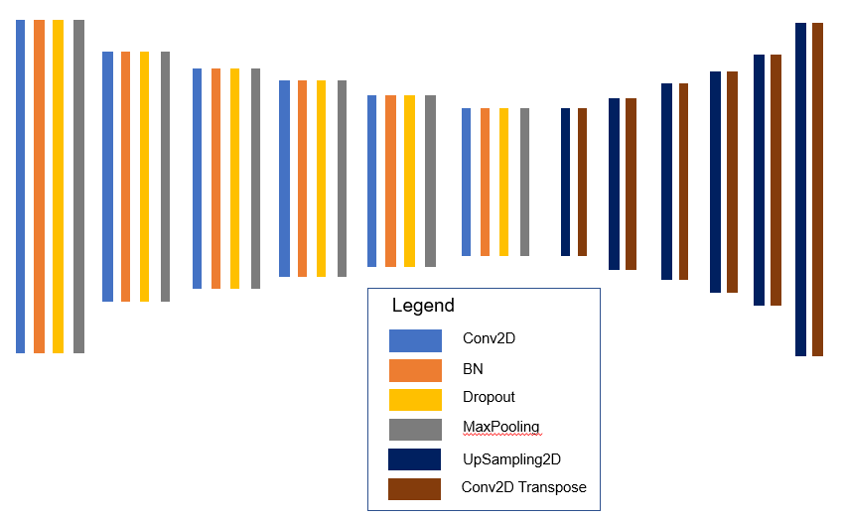
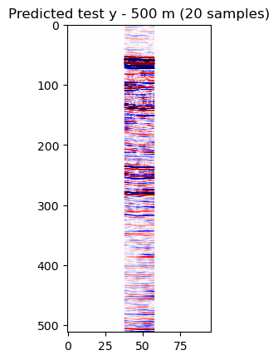
ML model - Autoencoder
Input
Prediction
Output

Slide 7
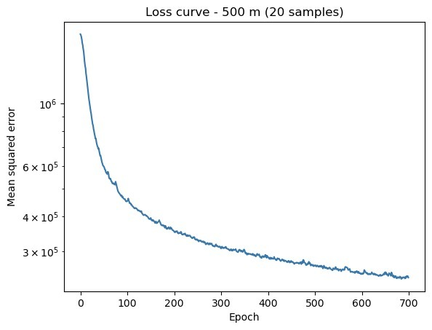
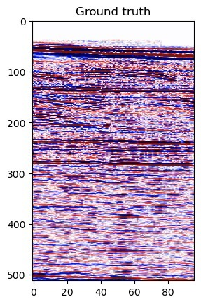
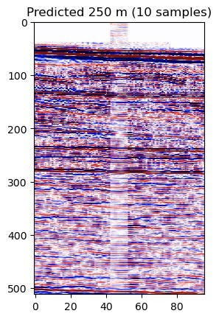
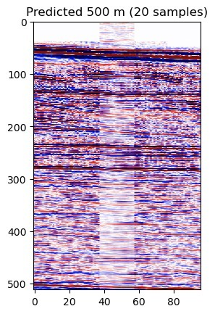
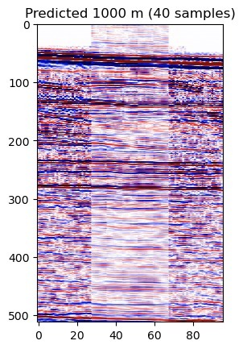
Results
SSIM : Structural Similarity Index
PSNR: Peak Signal-to-Noise Ratio
SSIM : 96%
PSNR: -4.6
SSIM : 93%
PSNR: -8.4
SSIM : 87%
PSNR: -11.3

Slide 8
Conclusion & Way Forward
Hypothesis: ML-based interpolation would struggle to fill in traces as gap size increases
Conclusion:
Autoencoder-based interpolation technique is able to fill in traces within the identified gap sizes.
However, there are some caveats:
Significant amplitude contrast at the boundary of prediction
Performance of autoencoder suffers as gap size increases
Way Forward:
Spend more time to do hyperparameter tuning, test autoencoder with different loss function, gradient descent methods, etc. to improve amplitude recovery of infilled traces
Extending 2D nature of the code in a 3D environment by utilising data in the crossline direction
Inter-offset contribution

Slide 9
Challenges & Lessons Learned
Challenges
Incorrect byte location during Penobscot gathers loading
Domain knowledge
Converting longitude/latitude into the XY coordinate using the right projection datum for synthetic seismogram
Lesson Learnt
Data is KING!
Always refer to official documents (repository website, acquisition/ processing report, etc.) to verify important acquisition and processing parameters
Spending more time on data investigation and train/test data preparation

Slide 10
Appreciation
Thanks to committee, mentors, organizers and judges for the opportunity
Work dedicated to Arvin’s Patti (Grandmother)

Slide 11
Open

